Slide 1
The Legal Status of De Facto Relationships
Professor Jens Scherpe
Aalborg University
&
Dr Andy Hayward
Durham Law School
jscherpe@law.aau.dk - a.p.hayward@durham.ac.uk
@JMScherpe @DrAndyHayward
Inner Temple, London
27th January 2027

Slide 2
Background

Slide 3
2005
Comparative study of some 12 jurisdictions (mostly in German)

Slide 4
2007

Slide 5
2017
Comparative study of 16 jurisdictions
Focusing only on formalised relationships beyond marriage
Different approaches to this type of relationship recognition:
As functional equivalents of marriage (esp. for same-sex couples)
As alternatives to marriage
Extending relationship recognition beyond conjugality

Slide 6
The Legal Status of De Facto Relationships (no fancy cover yet) 2023 (fingers crossed)
:
A comparative study of 38 jurisdictions from 6 continents
Started work on this in 2020

Slide 7
Countries Included - I
Europe
Belgium – Prof. Geoffrey Willems
Croatia – Prof. Branka Resetar & Dr Nataša Lucić
England & Wales – Prof. Jo Miles
France – Prof. Lukas Rass Masson
Germany – Prof. Anatol Dutta & Dr Charlotte Wendland
Greece – Dr Dafni Lima
Ireland – Dr Kathryn O’Sullivan
Italy – Prof. Stefania Stefanelli
Malta – Dr Ann Marie Mangion
Netherlands – Prof. Wendy Schrama
Norway – Prof. Tone Sverdrup
Poland – Prof. Arkadiusz Wudarski
Portugal – Prof. Rute Teixeira Pedro
Scotland – Prof. Kenneth McK Norrie
Slovenia – Prof. Barbara Novak
Spain – Prof. Josep Ferrer Riba
Sweden – Prof. Margareta Brattström
Asia
India – Sanskriti Sanghi
Israel – Dr. Sharon Shakargy
Japan – Prof. Yuko Nishitani
Macau – Prof. Guangjian Tu & Dr Cheng Hang Leong
PR China – Dr. Jianghao Xia

Slide 8
Countries Included - II
Oceania
Australia – Prof. Lisa Young
New Zealand – Prof. Margaret Briggs
Fiji – Prof. Jennifer Corrin
Vanuatu & Solomon Islands – Prof. Jennifer Corrin
North America
Canada – Prof. Robert Leckey
Jamaica – Prof. Tracy Robinson
Mexico – Dr. Denise Wiedemann
USA – Prof. Naomi Cahn & Prof. June Carbone
South America
Argentina – Prof. Victoria Pellegrini and Nieve Rubaja
Brazil – Dr Joanna Noronha and Helena Refosco
Chile – Prof. Fabiola Lathrop
Peru – Prof. Leysser Luggi Leon Hilario
Africa
Nigeria – Dr. Usang Maria Assim
South Africa - Prof. Julia Sloth-Nielsen
Uganda – Dr. Jamil Mujuzi

Slide 9
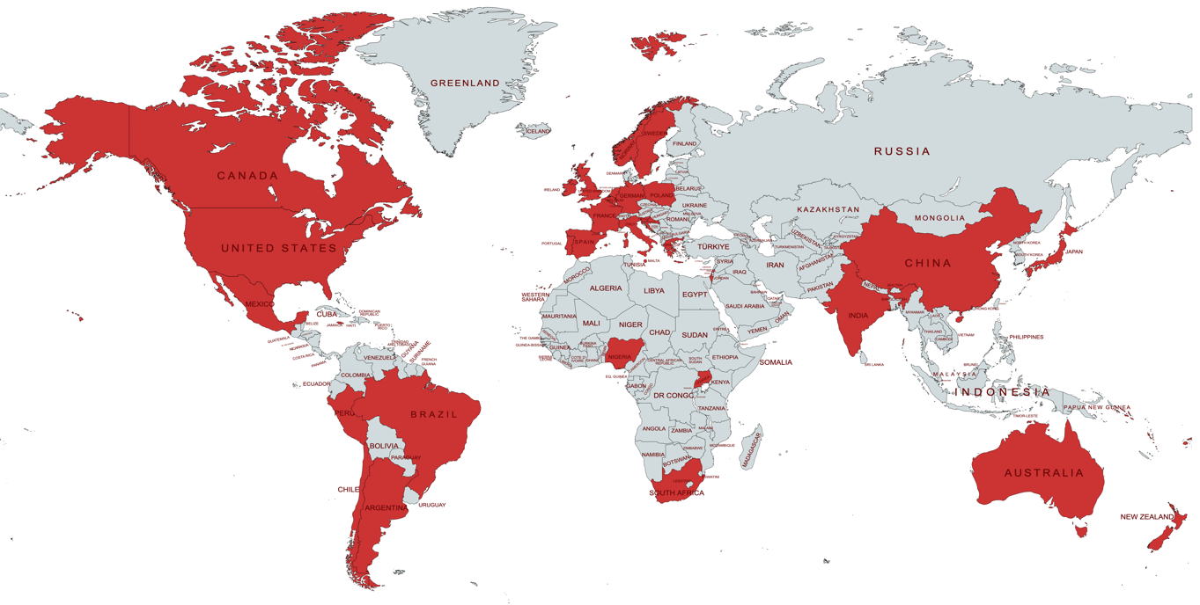
A Global Project

Slide 10
Terminology
Cohabitation ➔ de facto relationships

Slide 11
Main Challenges….
Very different social and legal cultures
Very different levels of acceptance of relationships outside of marriage, especially with regard to same-sex relationships
Difficulty of drawing boundaries between formalised relationships and de facto relationships
Limitation to conjugal relationships of two persons
Inter-connectivity of qualifying criteria and available remedies
Very different approaches to legal scholarship…

Slide 12
Questionnaire
Structure of adult relationship recognition; historical and social background; statistics
Qualifying criteria
Legal effects during the relationship
Legal effects upon separation
Legal effects upon death of one of the parties
Children
Current problems and debates

Slide 13
Overview

Slide 14
Framework for recognition of de facto relationships (Miles, ‘Cohabitation in a European Perspective’, in: Scherpe (ed.), European Family Law Vol. III, 2016, pp. 82-115)
Equality of de facto partners with marriage
1. Opt-in / Assimilation
3. Default / Assimilation
Protection of the economically vulnerable partner
Autonomy
4. Default / Different
2. Opt-in / Different
Preservation of the traditional family

Slide 15
Qualifying Criteria: Definition and Eligibility
Small number of jurisdictions have comprehensive statutory definitions of de facto plus eligibility criteria (e.g. NZ, AUS, IRE, CRO, SLO, POR, SWE).
Small number have less detailed statutory definitions and focus then shifts to judicial interpretation/development of principles (e.g. SCO, JAM, SPA, MAC).
Larger number have no single statutory definition, but courts have developed jurisprudence and/or tests (e.g. ENG, USA, ISR, GRE).
For those without specific de facto regimes, evidence of highly context-specific definitions of cohabitation used for specific purposes interpreted by courts (e.g. ENG, NET, POL).
Multiple statutory/case law definitions operating at the same time and for differing purposes can be an issue (e.g. NZ, AUS).
Interesting examples of eligibility criteria (e.g. SLO, MAC, POR).

Slide 16
Qualifying Criteria: Gender & Age
GENDER
Gender highly dependent on a jurisdiction’s approach to same-sex relationships (is a registered/civil partnership regime or marriage present?).
Large number of countries open regime to both mixed and same-sex couples.
Some countries expressly limit frameworks to mixed-sex couples (e.g. JAM, FIJ). others are reliant on court’s changing approach (e.g. GRE, JAP, PRC, MAC).
AGE
Examples of explicit age rules (e.g. IRE, POR, SWE, SLO, MAC) but even variation within a country (e.g. NZ).
Certain countries do not state explicitly but age requirement is inferred via age of majority, marriage rules (e.g. GRE) or the criminal law (e.g. BRA).
Evidence of countries reforming law to add in age requirement (e.g. SCO)

Slide 17
Qualifying Criteria: Consanguinity/Affinity & Conjugality
Considerable variation – some express prohibitions present (e.g. AUS (Com), MAC, SLO, IRE, SPA (Cat)).
Large number of countries leaving this open, but note general reluctance of the courts (e.g. ENG, GRE).
The use of the marriage-comparator for a large number of countries suggests the prohibition applies (e.g. JAM, SCO). Countries seeking to tighten this.
Multiple countries have seen the case law definition of cohabitant include conjugality or a sexual relationship (e.g. ISR, CAN, IND, MEX).
BUT sexual intimacy not always needed and the fact it has stopped does not prevent recognition (e.g. IRE).

Slide 18
Qualifying Criteria: Living Together
Sometimes living together is an essential factor (e.g. SCO, IND, JAP) that goes to proof of the existence relationship and ‘togetherness’ (e.g. CRO) or is a requirement for specific statutory entitlement.
More commonly, courts have been flexible – fact-based inquiry with absence of living together not always fatal, if judge satisfied a relationship is present (e.g. IRE, FRA, AUS, NZ, CAN, USA, GER, ISR, SWE, SPA, SLO).
Quite elaborate case law tests developed (e.g. POR, POL)
Evidence of living together PLUS sharing a household (e.g. SWE).
Evidence of statutory recognition of living apart (e.g. NOR).

Slide 19
Qualifying Criteria: Marital Comparison
Large number of countries use the marital comparator expressly (e.g. Can (BC), Can (Que), JAP, SPA) and others implicitly (e.g. CAN (Ont), GRE, ISR).
Australia uses both marital and neutral definitions via Commonwealth versus Western Australia regimes.
Often used to filter out prohibited degrees or non-conjugal relationships (e.g. NOR) and to ensure de facto relationships remain dyadic.
Linked to reputation and being externally considered/mistaken to be married (e.g. ISR)
However, shift towards neutrality e.g. ‘couple living together on a genuine domestic basis’ (AUS(Com) or ‘live together as a couple in an intimate and committed relationship (IRE).
Reform efforts to remove comparator (e.g. SCO)

Slide 20
Qualifying Criteria: Minimum Duration & Children
Considerable variation, dependent on context and legal entitlement sought.
Some jurisdictions have no express minimum duration (e.g. SCO, JAP, SWE, FRA SLO) but emphasis on stability thus ruling out transient relationships.
Some jurisdiction have express minimum duration periods
Portugal = 2 years
Ireland = 2 years or more plus children, 5 years in any other case
Australia, Macau, Catalonia = 2 years
New Zealand, Fiji = 3 years (but note ‘short duration)
Jamaica = 5 years
Divergence as to breaks. Some permit (e.g. NZ, JAM, SPA) some reject (e.g. IRE, CAN).
Children can either eliminate need to satisfy minimum duration (e.g. AUS, MEX) or shorten it (e.g. IRE, CRO).
Children play important role in establishing a de facto (e.g. NIG).

Slide 21
Qualifying Criteria: Concurrent Relationships
Many countries do not confront this point as no regulation exists.
Some outright reject recognition (e.g. MAC, SLO, SWE, BRA, MAL, POR) often based on marriage comparator or need to be in a relationship akin to marriage.
Some accept concurrent relationships but warn that claim may not succeed as cohabitant status might not be established.
A number of countries accept concurrent relationships provided the pre-existing marital tie of the other party is ‘dead’ (e.g. JAP, GER) or not active, yet subsisting (e.g. ISR, SPA(CAT)).
Ireland permits concurrent relationships but has strict statutory requirements.

Slide 22
Qualifying Criteria: Contracting In / Contracting Out
Relatively rare for countries to permit couples to contract into de facto regimes. Israel permits contracting into their ‘reputed couple’ regime, it is possible under Aragonese/Catalonian law and certain Australian states.
Malta is another interesting example.
More common to allow contracting out by couples:
But limits as to what can be jettisoned.
Variation as to procedural requirements e.g. writing, (independent) legal advice, signed, witnessed.
Variation as to ‘set aside’ power e.g. fraud, defeating creditors, contractual grounds, ‘serious injustice’ (IRE, NZ), ‘unconscionable conduct, impracticable implementation, changed circumstances’ (AUS).

Slide 23
Legal Effects During the Relationship: Property & Maintenance
Generally, existence of a de facto relationship does not change property relationship of parties (e.g. ENG, IRE, SCO, AUS, CAN, USA, UGA, NIG, GRE, MAC, JAP, CHI, GER, SWE, SPA).
Rare exceptions exist where some effects occur during the relationship (e.g. NZ, IND, JAM, JAP).
No duty to maintain or right to maintenance (but exceptions e.g. AUS(WA)).
Maintenance obligations tend to arise only upon separation.
Most countries do not recognize de factos as next of kin or have a legally recognised concept of next of kin.

Slide 24
Legal Effects During the Relationship: Other Rights
Tremendous variation as to rights and protections that arise while the de facto relationship is intact.
Most common rights afforded to de factos are:
Domestic abuse protections.
Visitation rights in prisons/hospitals.
Right to take medical decisions / representation rights (although nomination preferred).
De factos more likely to receive differing treatment regarding:
Tax – generally treated separately.
Immigration.
Workplace benefits/social security.

Slide 25
Legal Effects During the Relationship: Contracts
Contractualisation is a key theme and emerging trend, especially in countries without regimes e.g. USA post Marvin v Marvin and Belgium.
Evidence of contract law restrictions still being applied in certain countries such as natural justice, public order, or public policy (e.g. NIG), question as to application to same-sex couples (e.g. PRC) and reluctance to use contracts as a means of securing matrimonial entitlements (e.g. POL).
Tension between lex generalis and lex specialis when it comes to setting aside contracts. Some jurisdictions regulate using general contract rules (e.g. CAN(QUE)) whereas others supplement those with family law considerations such as improper advantage (e.g. CAN(BC)), failure to disclose assets (e.g. CAN(BC), CAN(ONT)), injustice (e.g. JAM).
Most countries permit contracts but may limit what you can contract out of (e.g. SWE).

Slide 26
Legal Effects upon Separation: Termination and Remedies
Termination is a question of fact and informal. Some expressly regulate when a de facto relationship ends (e.g. SWE, MEX, POR).
Often evidential issues arise, as with determining start date.
Considerable variation as to remedies and rationale:
Community of property / rule-based sharing arises (e.g. NZ, SWE, JAM).
Equitable distribution (e.g. AUS).
Compensation/Damages-type claims (e.g JAP, IRE, SCO, CAN(BC)).
General law claims such as contract, unjust enrichment, modified judicial devices such as partnerships (e.g. GER), damage claim (e.g. JAP).

Slide 27
Legal Effects upon Separation: Hierarchy
Generally, where concurrent relationships are recognized there is a range of responses. Note some countries will not recognize at all (e.g. CRO).
Some jurisdictions privilege the marital relationship over the de facto, (e.g. NIG, IND), especially where marriage is constitutionally protected (e.g. IRE).
Some jurisdictions prefer to prioritise the relationship that is active (e.g. ISR)
Others impose no hierarchy (e.g. CAN(BC), CAN(ONT), NZ, AUS) but note the evidential difficulties of proving de facto status in these circumstances.
Where general law applies, look at the equities/first in time.

Slide 28
Legal Effects upon Separation: Time Limits
Where a de facto regime exists, likely to have a specific time bar for bringing claim, often calculated from when the relationship ends:
1 year – SWE, SCO, JAM
2 years – AUS, IRE
3 years – NZ, PRC.
Some evidence of inability to extend e.g. SCO but under review.
Some power to extend the time period e.g. NZ, JAM, AUS(COM), if parties agree.
Where a specific regime does not exist, general law applies thus statute of limitations / equitable principles ‘delay defeats equity’

Slide 29
Legal Effects upon Separation: Additional Claims/Jurisdiction
Where de facto regime exists the question of additional claims arises.
Evidence of no restriction of claims under general law and de facto law:
sometimes encouraged to strengthen chances of recovery (e.g. IRE).
sometimes needed if property falls outside regime (e.g. NZ, CAN).
sometimes needed if applicant falls outside regime (e.g. JAM, AUS).
However, questioned whether general law should be developed, if specialized law exists e.g. SWE.
Considerable variation as to which courts hear these claims with family courts (where available) being used if where de facto regulation is present versus ordinary courts, where it is not.

