Slide 1
RC21: Towards computer-assisted concordance reading
NATALIE FINLAYSON ● ALEXANDER PIPERSKI ● STEPHANIE EVERT ● MICHAELA MAHLBERG
UNIVERSITY OF BIRMINGHAM ● FRIEDRICH-ALEXANDER-UNIVERSITÄT ERLANGEN-NÜRNBERG
Notes:
Newness of project

Slide 2
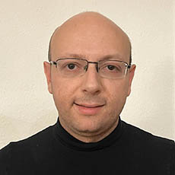
Introduction
Dr Natalie Finlayson (RF, UoB)
Dr Alexander Piperski (RF, FAU)
Prof Stephanie Evert (PI, FAU)
Prof Michaela Mahlberg (PI, UoB)
Funded jointly by the AHRC (AH/X002047/1) and Deutsche Forschungsgemeinschaft (German Research Foundation; 508235423)
Pool expertise in theoretical foundations of CL (UoB) and quantitative methods, corpus processing and NLP algorithms (FAU)
Develop an innovative, systematic approach to concordance reading
Today: 1. Overview of context (who, why) 2. Fundamental, tool-independent strategies for reading 3. Progress towards developing FlexiConc software
2
@rc21project #rc21
Notes:
Introduce selves, presenting on behalf of the RC21 team
Cross-institutional project funded by AHRC and DFG to pool expertise in theoretical foundations in CL (Bham) and quant/stats methods (FAU) in a cross-linguistic investigation to explore the full potential of concordance reading, and systematically describe and support strategies of reading concordances.

Slide 3
1. Concordances across languages and disciplines
Notes:
Two things that are novel about this study:
(i) cross-linguistic; a lot of what we plan to do is going to be carried out in both English and German, broaden out approaches to concordance reading which have been very focused on the English language so far and ensure findings apply to a broad range of cases beyond English
(ii) looking at this from the perspective of different disciplines to find commonalities in what researchers in different subject areas are doing

Slide 4
Who benefits from concordance analysis?
Established areas
Lexicography
Identifying lexical units of meaning and describe their semantic, lexical and grammatical usage patterns
Data-driven learning (DDL)
Language students interact directly with corpus data via concordances to focus on units of meaning and better grasp usage contexts
Corpus-assisted discourse studies (CADS) Analysis of socio-political discourses
Evolving areas
Digital Humanities
Bridging the gap between quantitative and qualitative approaches; one of the most fundamental issues in DH
Computationally-supported social sciences
Currently rely mainly on quantitative techniques; adding a qualitative element
Argumentation mining
Investigate non-standard argumentation and extract patterns with corpus queries
4
@rc21project #rc21
Notes:
Deciding on areas of focus
Established = used from the beginning
Evolving = starting to look at concordances in a more structured way, looking across boundaries
Literary stylistics: concordance reading central element of literary stylistics; a lot of new stuff is happening
CADS and corpus stylistics probably same timing, but what is developing is cross-discipline approaches

Slide 5
Disciplines of focus
Established areas
Lexicography
Identifying lexical units of meaning and describe their semantic, lexical and grammatical usage patterns
Data-driven learning (DDL)
Language students interact directly with corpus data via concordances to focus on units of meaning and better grasp usage contexts
Corpus-assisted discourse studies (CADS) Analysis of socio-political discourses
Evolving areas
Digital Humanities (literary stylistics)
Bridging the gap between quantitative and qualitative approaches: one of the most fundamental issues in DH
✓ Important fields with a lot of momentum
✓ Sufficient amount of attention
✓ Specialist knowledge
5
@rc21project #rc21
Notes:
Fields with a lot of momentum, we are specialists, they are important, sufficient amount of attention

Slide 6
What is a concordance analysis (for)?
Lexicography: make informed decisions about which words to include [...] how to order different parts of speech [...] how to sequence different meanings (Viana, 2022: 4)
A concordance illustrates typical patterns.
But different research questions and applications demand a focus on different aspects of similarity.
Systemic review needed
DDL: may help learner development […] increased language sensitivity, noticing, induction, and ability to work with authentic data (Boulton & Cobb, 2017: 349)
CADS: link large-scale social phenomena with linguistic choices at the micro level (Gillings et al., 2023: 23).
Stylistics: results that are difficult to gain when relying on introspection (Stubbs, 2005; Kubis, 2021; Fischer-Starcke, 2010; Mahlberg et al. 2016)
6
@rc21project #rc21
Notes:
Read blue box
We are undertaking a systematic review of how and why concordance analysis is done in each of these areas
Results will inform the development of tools that can be used effectively in multiple disciples
But – challenge – the understanding of the purpose of a concordance differs across disciplines

Slide 7
2. Fundamental strategies for reading concordances
Notes:
The language used to describe the steps taken to read concordances also varies across disciplines, even though – so far – we think researchers across disciplines are more or less doing the same thing.
One problem is that these steps are not always clearly laid out in the methods sections of research papers.
Another is that choices for the organisation of concordances are determined by the intuition of experienced analysts and by technical affordances of concordance software.
Our project aims to bring some systematicity to this process of reading concordances, and a terminology for doing so that can be used consistently across disciplines.

Slide 8
Early approach towards a systematic account of reading concordances (Sinclair 2003)
1. Initiate. Decide on the strongest patterns to the L/R (e.g., recurring word forms, recurring part of speech, side with most repeated words) 2. Interpret. Find a hypothesis that links (most of) them (lexical, semantic, syntactic) 3. Consolidate. Look for other evidence to support the hypothesis 4. Report. Write out an explicit, testable version for the future. 5. Recycle. Repeat steps 1-4 with the next most important pattern. Keep going until you can’t find any more patterns. Classify remaining lines as either unusual or a different pattern. 6. Result. Report a list of final hypotheses. 7. Repeat. With your report and a new selection from the corpus
How?
Working hypothesis: Across disciplines, we identify four reading strategies
8
@rc21project #rc21
Notes:
Early approaches towards a systematic account of ‘reading concordances’; best known has only selectively been taken forward
1+2 is the iterative part, 5 repeated for the rest of the model ( selecting operation).
Decide and find are vague active verbs
Our algorithms primarily support researchers in steps 1. + 2.; when a pattern is identified, 5. repeats the analysis with the remaining concordance lines (i.e. 5. is actually a Selecting operation). The overall iterative process needs to be supported by an interactive concordancing tool and visualisations, e.g. take an identified pattern and move the concordance lines to one side (or grey them out or so).
It is possible that some of our algorithms – in particular Structured Sorting – could be seen as trying to encompass the entire iterative process.

Slide 9
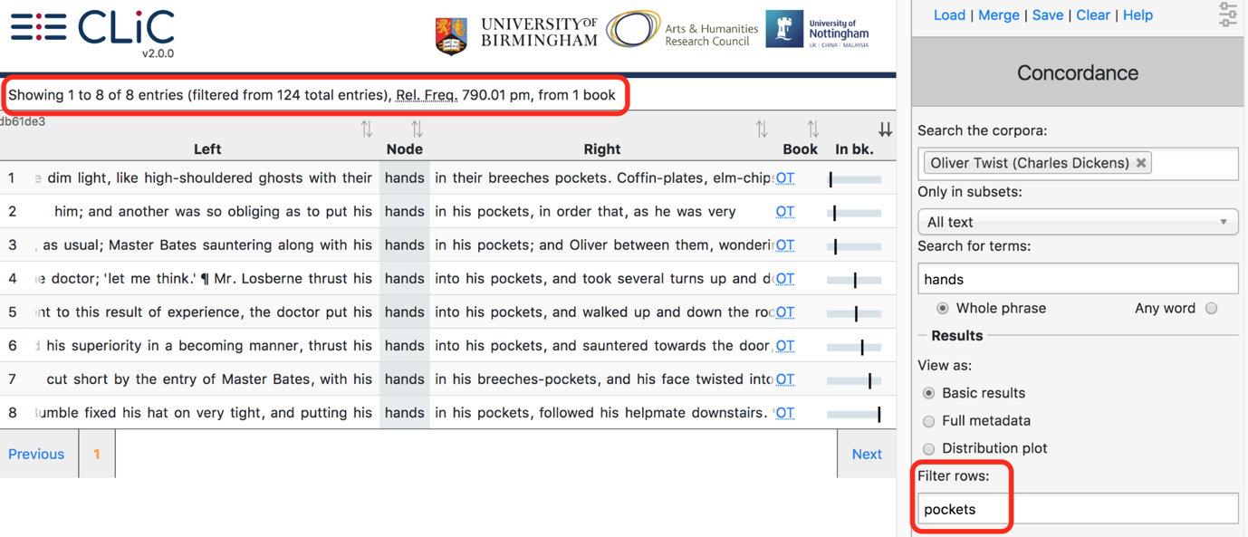
1. Selecting
Focussing on a subset of lines, either randomly or according to predefined categories (e.g., presence of a specific word or sequence; metadata)
DDL: using CQL to select lines that show appropriate usage of a pattern for the purposes of personalised student feedback (Vincent & Nesi, 2018)
Stylistics: using CLiC to select only lines that also contain the word pockets
9
@rc21project #rc21

Slide 10
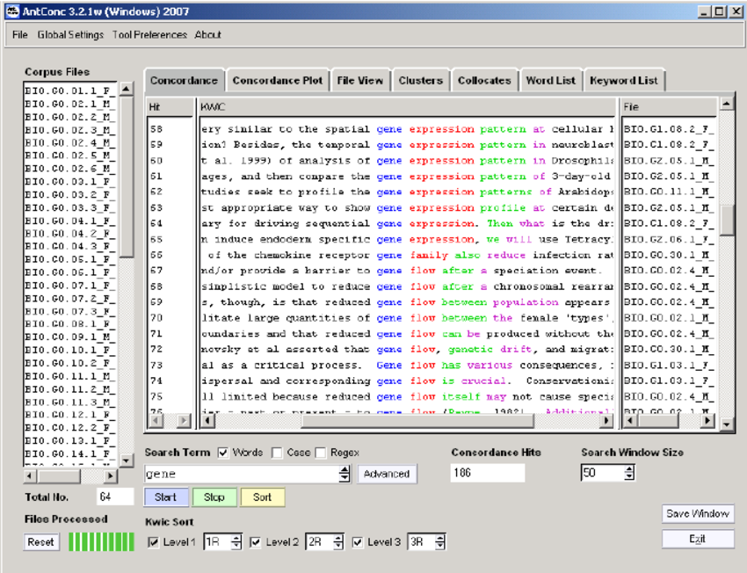
2. Sorting
Reordering lines so that instances of recurring patterns or metadata appear next to each other (e.g., alphabetical sorting, by year, by text type …)
DDL: sorting alphabetically R/L show common patterns exemplifying determiner and adjective use with have + effect (Vincent & Nesi, 2018)
CADS: sorting alphabetically by R1 and then node to see occurrences for hacking that occur after different country names (Pei et al., 2022)
10
@rc21project #rc21

Slide 11
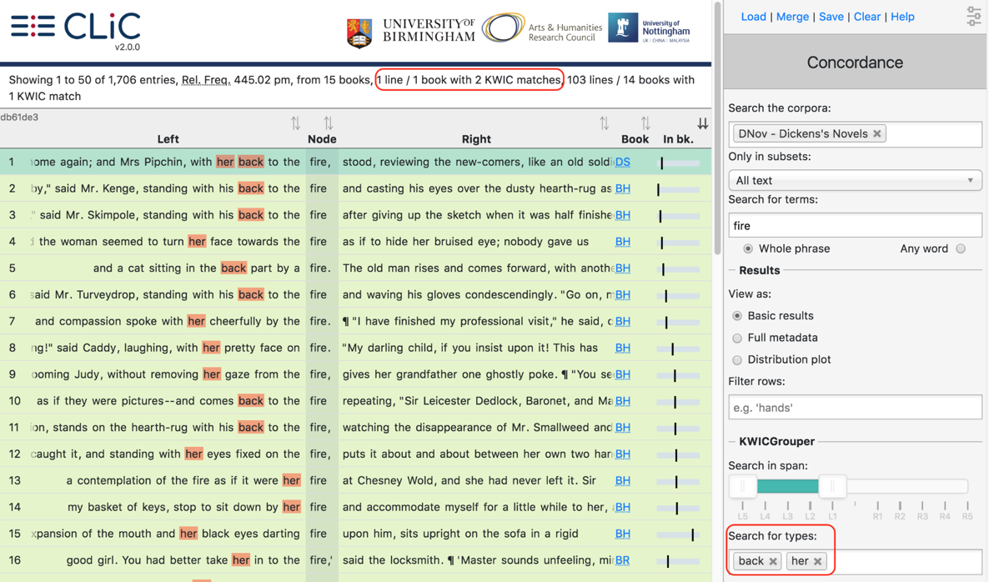
3. Ranking
Highlighting the most useful or important concordance lines based on numeric scores or value judgments (e.g., frequency, best example)
DDL: ranking lines containing [V] like a/an [N] and as [ADJ] as a/an [N] by pattern frequency to identify clichéd similes (Finlayson, 2022)
Stylistics: Using KWICGrouper in CLiC to display the lines that contain the greatest number of targeted words at the top
11
@rc21project #rc21
Notes:
Update to the same example search

Slide 12
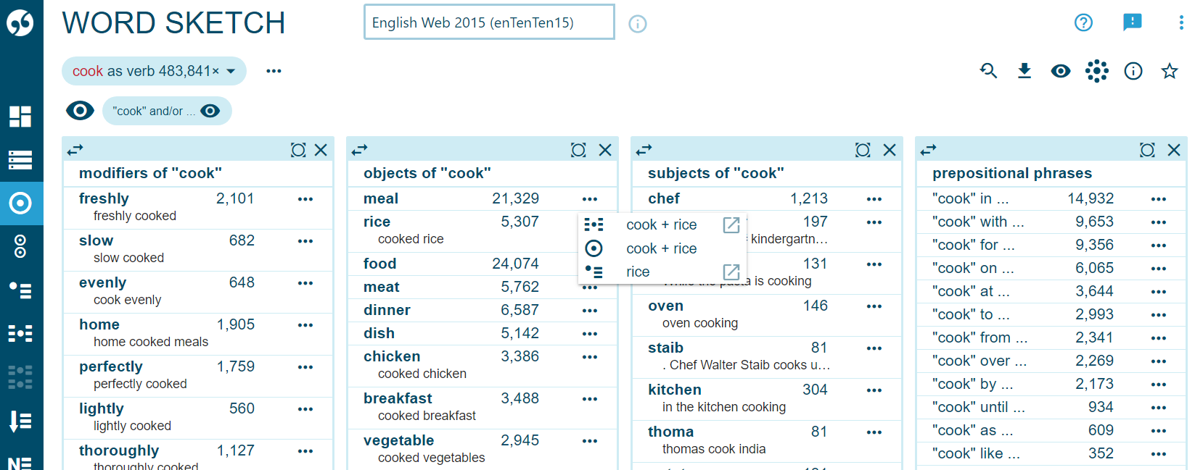
4. Clustering
Grouping concordance lines based on observed similarities (e.g., lexis, syntax, semantics)
Lexicography: using Word Sketch to distinguish between different senses of words for dictionary entries (Moore, 2023)
CADS: grouping lines by local textual function to describe social aspects of the meaning of sustainable development (Mahlberg, 2007)
12
@rc21project #rc21
Notes:
As you can see, different fields are doing similar things, for different purposes, with different terminology

Slide 13
Extending an early approach towards a systematic account of reading concordances (Sinclair 2003)
1. Initiate. Decide on the strongest patterns to the L/R (e.g., recurring word forms, recurring part of speech, side with most repeated words) 2. Interpret. Find a hypothesis that links (most of) them (lexical, semantic, syntactic)
Fundamental strategies for reading concordances? Selecting, sorting, ranking, clustering
If so, fundamental for what, and to whom? English? Or other languages?
Outputs: → define these terms using language common to the four disciplines → develop a set of recommendations for writing methods section (e.g., Gillings & Mautner, forthcoming, IJCL) → implement tools to support the above
How?
13
@rc21project #rc21
Notes:
To conclude this section

Slide 14
3. Developing ‘FlexiConc’

Slide 15
FlexiConc
Python library to be integrated into existing tools
Standalone demonstrator app
Provide a wide range of algorithms for general strategies and eventually combine them into pipelines
systematic
well-documented
theoretically grounded
Support for the human analyst! (not fully automatic)
15
@rc21project #rc21

Slide 16
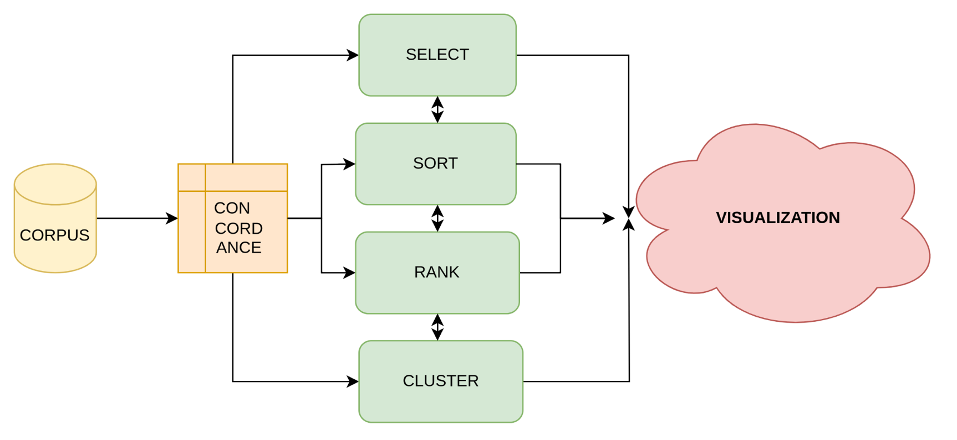
Concept
16
@rc21project #rc21

Slide 17
FlexiConc: Challenges
No standard commonly used data models for representing corpora and concordances
FlexiConc must process input data from the APIs of various corpus tools (SketchEngine, CLiC, …)
FlexiConc must output data in a format that can be integrated into various corpus tools
17
@rc21project #rc21

Slide 18
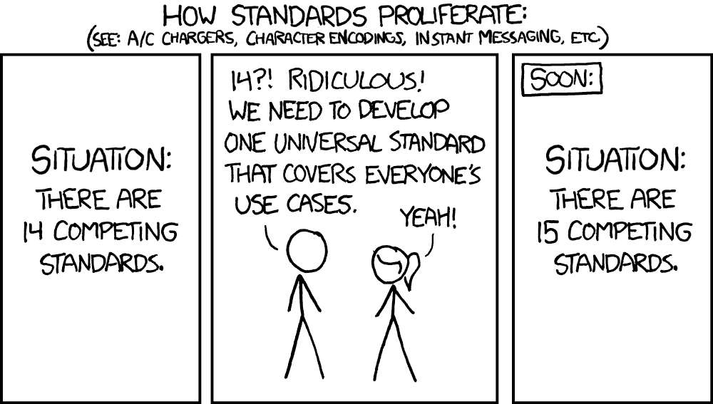
https://xkcd.com/927/
18
@rc21project #rc21
Notes:
Selecting and sorting get more attention from the developers of existing tools than ranking and especially clustering
Clustering can be based on
lexical similarity
syntactic similarity
semantic similarity
Clustering visualisation:
tree-like structures
ranked list of clusters with selected examples

Slide 19
Concept ctd.
19
@rc21project #rc21

Slide 20
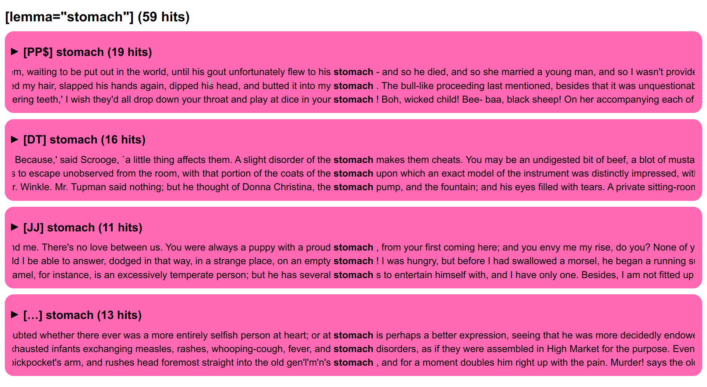
PoS tree (prototype 1)
20
@rc21project #rc21
Notes:
Say about clustering + sorting + ranking

Slide 21
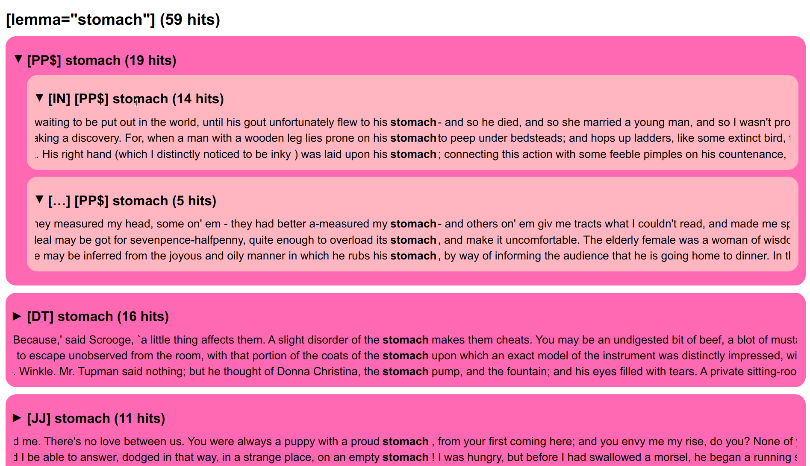
PoS tree (prototype 2)
21
@rc21project #rc21

Slide 22
FlexiConc: Wish list
If you can think of ways of organising concordance lines that can be automated and are not yet implemented in existing tools, feel free to share your ideas!
22
@rc21project #rc21

Slide 23
4. Conclusions

Slide 24
Take home messages for today
Conclusions
Challenges
1. Concordance analysis is used in different disciplines to identify recurrent patterns in language
2. There seem to be four tool-independent strategies for concordance reading: selecting, sorting, ranking, clustering
3. These tool-independent strategies should be supported by transparent, theoretically-grounded tools
What counts as a pattern in different disciplines is often not clearly defined
Researchers in different disciplines use different language to talk about doing the same thing
Standardization and compatibility with existing tools
24
@rc21project #rc21
Notes:
More reproducibility
Benefit of systematicity: presentation of discipline beyond corpus linguistics

Slide 25
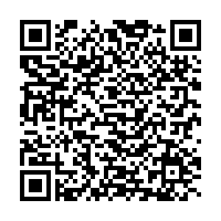
Q&A
Thank you for listening!
@rc21project
birmingham.ac.uk/rc21
25
@rc21project #rc21

